Slide 1
Project 4 Presentation
Andrew Lounsbury Joshua Aldridge Kirill Zavalin Mada Subaiti Seth Beverley

Slide 2
Project analysis slide 2
Project 4 Overview
Medical Diagnosis
PROJECT 4
Image Recognition
Word Prediction

Slide 3



Project analysis slide 4
Methodology
Output
Disease Predictor (Medical Diagnosis)
Supervisor
Training Data set
Desired Output
Management Objectives
Input Raw Data
MRI Model
(Image Recognition)
Customer Objectives
Quote Actor Predictor
(Word Prediction)
Algorithm
Processing

Slide 4
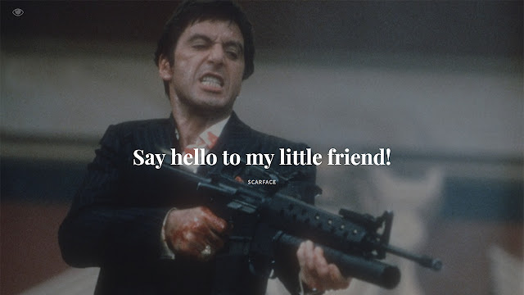
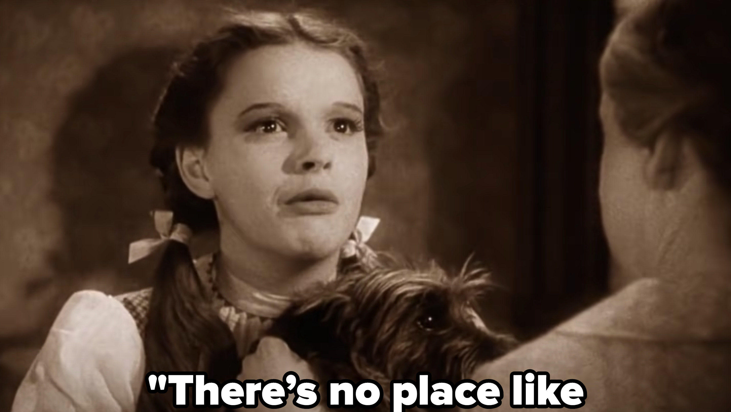
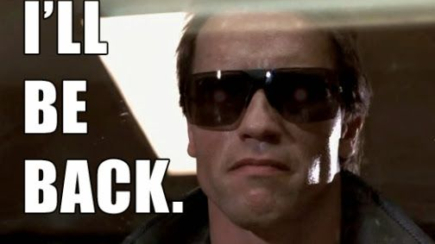
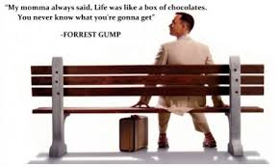
Word Prediction: Which Movie Star Would Be Most Likely to Say a Particular Quote?

Slide 5
WORKFLOW:
IMDB database for movies, movie actors, and roles they played
Cornell Movie-Quotes Corpus database for quotes per character
Pick top 30 actors
Train long short-term memory (LSTM) neural net to model quotes for each of the top actors
Write a function for predicting which actor might say a quote

Slide 6
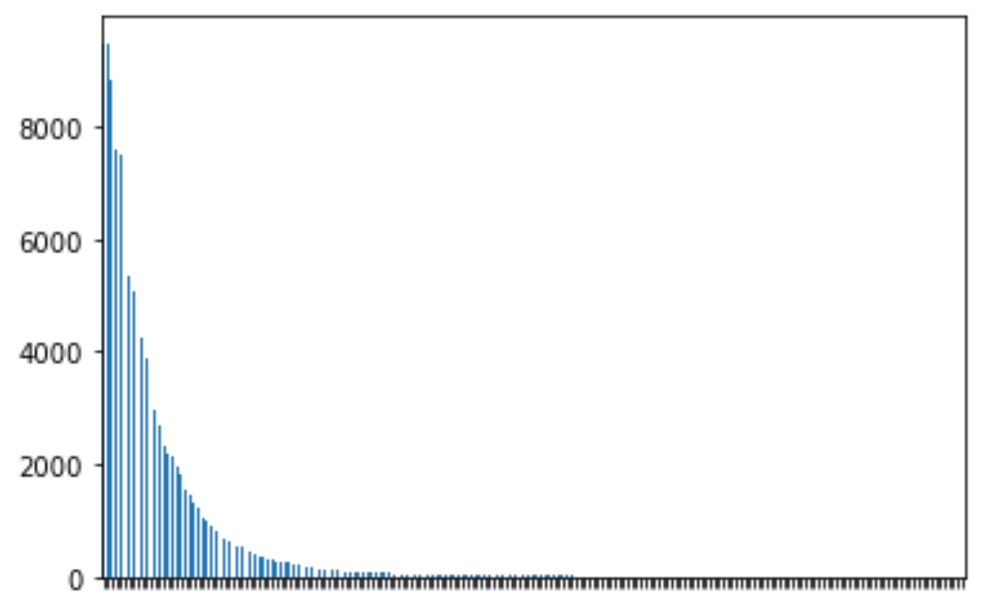
Project analysis slide 5
Word Prediction
Analysis
Length of Quotes for Top 30 Movie Actors
Number of Instances
0
563
To optimize performance, we
avoided outliers and used the
.995 Quantile = 89 words
Number of Words in a String

Slide 7
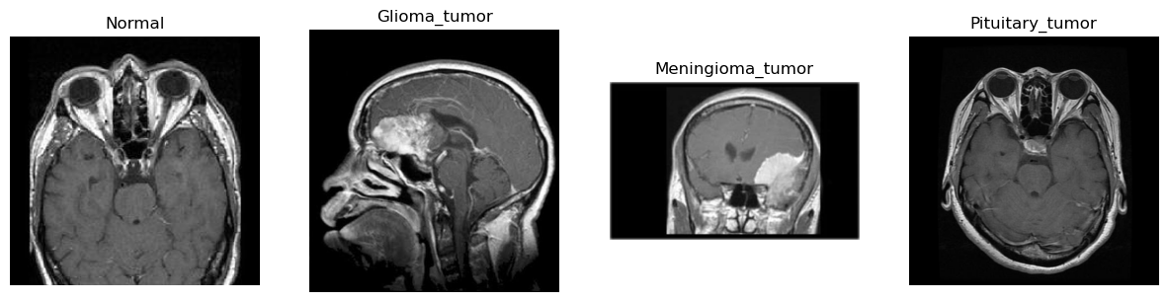
Project analysis slide 6
Image Recognition
Analysis
This dataset consists of four classes, including three tumor classes (Pituitary, Glioma and Meningioma) and one class representing normal brain MRI scans.
Databases Used: Kaggle
The initial data source for this dataset is the brain tumor classification MRI dataset

Slide 8
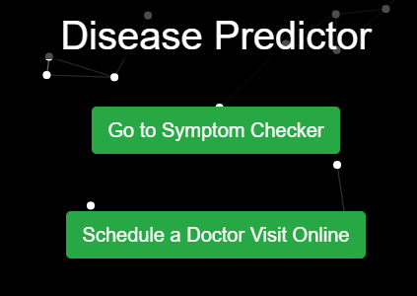
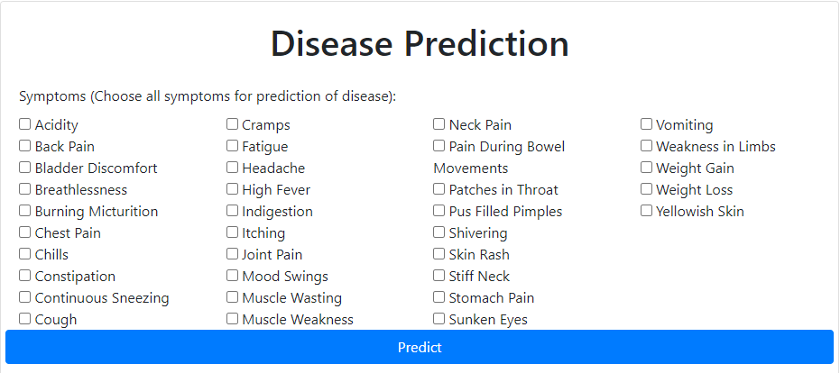
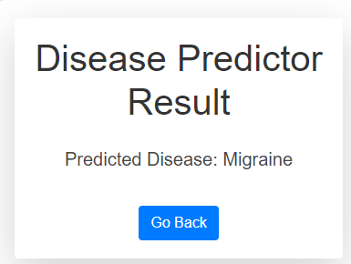
Project analysis slide 7
Medical Diagnosis
Analysis
Databases Used: Cornell

Slide 9
Thank You

